Slide 1

Grid Guardian – AI-Powered Fault Diagnosis & Carbon-Aware Monitoring
Team: Epoch Explorer – Sourav Kumar Pradhan, Souvik Roy, Rupankar Chakraborty, Prasun Koyal, Samyadeep Kuila
Mentor: Saurav Chatterjee
Acknowledgment: Kolkata AI Program Team, Abhinandan Banerjee, Bratati Roy

Slide 2

Problem Statement
Core Problem
Current Challenges
Grid operators require rapid fault diagnosis to reduce downtime & service disruption.
Legacy SCADA, rules-based alarms
Risk of cascading failures
Lack of explainable corrective measures
Limited integration of carbon footprint & sustainability insights
Goal
Expected Output
Predict faults in real-time, identify root cause, and provide actionable corrective measures
Fault type (Overheat, Undervoltage, Power Surge, Low Power)
Key parameter causing fault
Integrate carbon-aware operations
Stepwise CoT-based corrective action

Slide 3

Migration from Legacy Systems
01
Approach
Deploy Agentic AI + RAG-enabled LLM alongside legacy SCADA
Gradual shift from advisory → semi-automated → automated alerts
Challenges & Solutions
Challenge
Solution
Hallucinations from LLM
Structured CoT + RAG retrieval from SOP/manuals
Diverse sensor formats
Standardization & preprocessing
Regulatory compliance
Human-in-loop, logging, audit trail
Outcome: Safe & explainable corrective actions with non-disruptive integration into existing SCADA

Slide 4
What We Did – Detailed Technical Summary
1
Synthetic SCADA Data Generation
Objective: Generate realistic training datasets without live SCADA access.
Agents: Power Plant & Distribution Substation.
Simulated Parameters: Voltage (kV), Current (A), Temperature (°C), Humidity (%)
Fault Labeling (SCADA-inspired logic):
Overheat
Undervoltage
Temperature > 60°C
Voltage < 10.5 kV
Power Surge
Low Power
Current > 150 A
Current < 80 A
Implementation: Each row evaluated to assign fault label, mimicking SCADA alarms for supervised ML training.
Takeaway: Enables safe, realistic, and labeled datasets for training and testing ML models in power systems.

Slide 5
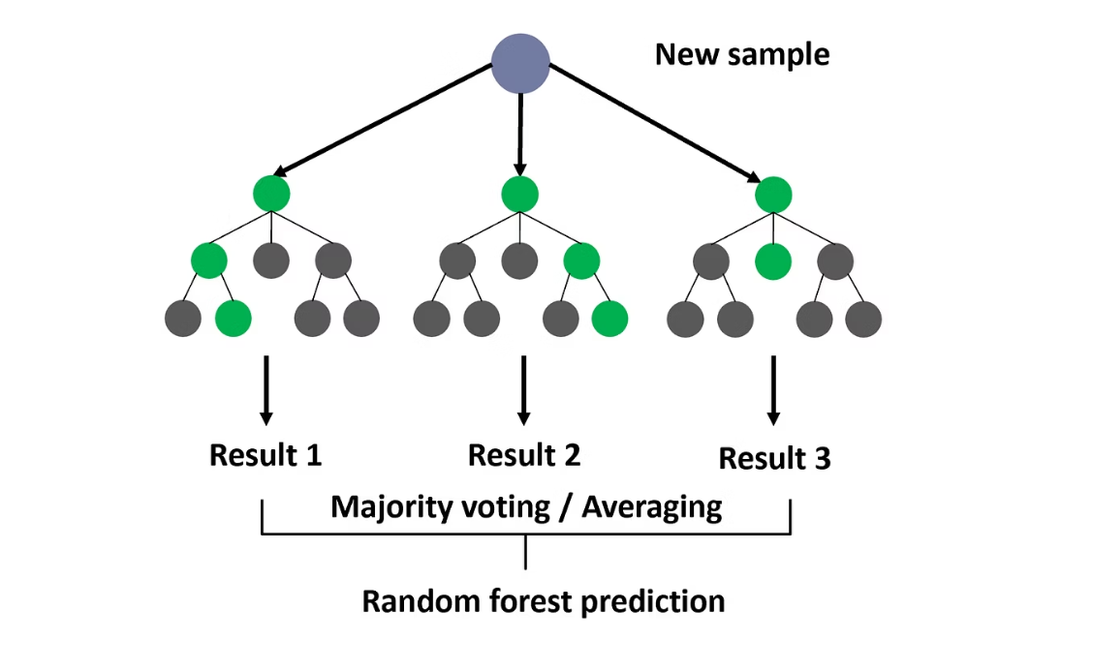
Random Forest Classification & LLM Chain-of-Thought
Random Forest Classification
Purpose: Classify faults using SCADA-like sensor readings.
Why Random Forest fits our scenario:
Handles mixed numerical features robustly
Resistant to noise and outliers, common in SCADA data
Provides feature importance, identifying the sensor driving the fault
Scalable to synthetic and real-time streaming datasets
Bootstrap Sampling
Decision Tree Training
Multiple random subsets of training data
Each tree splits data on features to classify fault
Ensemble Voting
Feature Importance
Majority vote across all trees → final fault label
Identifies which sensor parameter contributes most to fault
LLM Chain-of-Thought (CoT) Reasoning
Purpose: Convert ML predictions into stepwise, actionable guidance for operators.
You are an electrical fault diagnosis expert.Entity: {entity_id}Fault Detected: {fault_label}Key Parameter: {reason_feature} = {reason_value}Provide step-by-step corrective actions for safe resolution.(Optional) Include carbon-aware guidance if available.
Fault
Key Sensor
Value
CoT Corrective Steps
Overheat
Temperature
67°C
1️⃣ Reduce load gradually 2️⃣ Activate backup cooling 3️⃣ Redistribute load 4️⃣ Log intervention

Slide 6




Streamlit Dashboard & System Workflow
Raw Sensor Table
Predicted Fault Table
Voltage, Current, Temperature, Humidity with real-time updates and color-coded thresholds
Fault type, key sensor, value, CoT corrective steps with carbon impact estimates
Trend Charts
Real-Time Simulation
Voltage, Current, Temperature over time with predictive analytics overlay
Adjustable iterations & interval for live operational demonstration
System Workflow
SCADA Data
Key Parameter
CoT Steps
Sensor readings collected
Root cause identification
Actionable guidance
1
2
3
4
5
6
Random Forest
LLM Prompt
Dashboard
Fault classification
Context generation
Operator interface
Key Outcomes: Rapid fault detection aligned with SCADA logic, stepwise explainable corrective guidance, and real-time dashboard visualization for operational decision-making.

Slide 7

Why Random Forest & Alternative Approaches
Random Forest High-Level Flow
1
2
3
4
Build Multiple Trees
Tree Predictions
Aggregate Votes
Feature Importance
Random subsets of data/features
Each tree predicts fault label
Final prediction from majority
Identify key sensor causing fault
CoT Prompt Example
Fault: Overheat, Temperature = 67°CReason: High Temp triggers turbine stressLLM Action: 1️⃣ Reduce load gradually 2️⃣ Check cooling fans 3️⃣ Redistribute load 4️⃣ Monitor CO₂ impact 5️⃣ Log for compliance
Why Random Forest
Alternatives
Handles mixed numerical features (Voltage, Current, Temp, Humidity)
XGBoost / LightGBM / CatBoost → higher accuracy, similar interpretability
Noise-tolerant and interpretable
Provides feature importance → feeds LLM for reasoning
LSTM / Temporal models → capture temporal dependencies for predictive maintenance
AutoML pipelines → continuous retraining on SCADA streams

Slide 8








Dynamic Agentic Workflow
Power Plant Agent
Distribution Substation Agent
Monitors generation units and primary equipment
Oversees distribution networks and secondary systems
GNN Optimization
Auto-detection
Nodes = plants/substations, edges = transmission lines
Dynamically classify entity based on voltage/current patterns
Edge Deployment Architecture
Edge Processing
Cloud Aggregation
Lightweight agents at substations for low-latency alerts
Centralized dashboard & analytics
Real-time fault detection and immediate response
Multi-agent coordination
Reduced network dependency
Historical data analysis and reporting
Value for Manufacturers & Stakeholders: Faster fault resolution → reduced downtime → operational savings, predictive maintenance → lower carbon footprint, ESG reporting & compliance → investor confidence

Slide 9







Real-Time AI Corrective Alert Flow
SCADA Data
Random Forest
Fault Label
Key Parameter
LLM CoT + RAG
Corrective Action
Dashboard Alert
Real-time sensor readings
Fault classification
Identified fault type
Root cause analysis
Reasoning generation
Step-by-step guidance
Operator interface
CoT Corrective Action Examples
Fault
Key Parameter
LLM CoT Action
Overheat
Temp = 67°C
1️⃣ Reduce turbine load gradually 2️⃣ Increase coolant flow 3️⃣ Check fan & pump 4️⃣ Redistribute load to balance thermal stress 5️⃣ Monitor CO₂ intensity & efficiency 6️⃣ Log action for compliance
Undervoltage
Voltage = 10.2 kV
1️⃣ Check transformer taps 2️⃣ Rebalance feeder load 3️⃣ Verify grid supply from upstream 4️⃣ Adjust capacitor banks 5️⃣ Log & monitor
Alert Mechanism
Severity-based: advisory vs critical
Channels: Dashboard, SMS, SCADA triggers
RAG ensures: SOP-compliant & safe execution

Slide 10
Dashboard Snapshot & Future Enhancements
Dashboard Layout Overview
Raw Sensor Data
Predicted Faults
Trend & Carbon Chart
Real-time sensor feed with color-coded thresholds and export capabilities
Fault table with step-by-step corrective actions & carbon impact
Interactive charts showing trends over time with sustainability insights
Future Enhancements
01
02
03
Carbon-Aware Corrective Measures
Topology-Aware Fault Prediction with GNN
RAG + SLM Fine-Tuning
Integrate real-time carbon intensity per kWh from CEA & plant-specific emission data. LLM suggests actions that reduce CO₂ footprint while maintaining operational efficiency.
Represent the grid as a graph with GNN predicting cascading fault propagation across the network, enabling prioritized interventions.
Retrieval-Augmented Generation injects knowledge from SOP manuals, while structured LLM fine-tuning ensures domain-specific, safe recommendations.
04
05
Enhanced Dashboard Visualization
Edge + Cloud Integration
Combine operational KPIs (uptime, load factor, MTTR) with carbon footprint trends for comprehensive stakeholder monitoring.
Edge deployment for real-time processing at substations with cloud orchestration for centralized monitoring and multi-agent coordination.

Slide 11
Our Data Foundation: Key Sources & References
Our analysis and models are built upon robust datasets from credible industry and government sources, ensuring accuracy and reliability.
CEA
Central Electricity Authority (India) provides plant-wise emission factors, crucial for our carbon-aware monitoring.
POSOCO
Power System Operation Corporation Ltd. offers comprehensive grid operation metrics, essential for real-time fault diagnosis.
Data.gov.in
The Government of India's open data portal provides extensive power generation data, supporting our broader insights.
CESC
Calcutta Electric Supply Corporation's data informs our carbon emissions metrics and regional analysis.
EESL
Energy Efficiency Services Limited provides critical energy efficiency benchmarks for our comparative analysis.

Slide 12

Thank You & Questions
We extend our sincere gratitude for your attention and engagement today. This presentation would not have been possible without the invaluable guidance of our mentors and the tireless dedication of our entire team.
We are now open to any questions you may have and welcome further discussion on our findings and future directions.

